Slide 1


SIMATS ENGINEERING
SAVEETHA INSTITUTE OF MEDICAL AND TECHNICAL SCIENCES
ENERGY INSIGHTS OS-AUTOMATED GRID AND RESOURSE DATA DISCOVERY PLATFORM
DSA0404 – Fundamentals of Data Science
Date : Batch :
Guided by:
Dr. Krishnaraj Mony
Associate Professor/CSE
Presented by:
P.Jeevan Kumar
Ganesh Kumar H
Gandluri Veda Vikas Gowd

Slide 2



INTRODUCTION
InsightOS is an intelligent platform that automates Exploratory Data Analysis (EDA) to simplify data analysis.
It automatically performs data profiling, preprocessing, visualization, and statistical analysis on uploaded datasets.
The system identifies missing values, duplicate records, outliers, and hidden patterns with minimal user intervention.
It generates explainable insights, interactive dashboards, and professional analytical reports for better decision-making.
The platform reduces manual effort, saves time, and makes advanced data analytics accessible to students, researchers, and organizations.

Slide 3

OBJECTIVES
Intelligent Dataset Upload
Develop a system capable of accepting CSV and Excel datasets while automatically identifying schema, data types, and dataset structure.
Automated Data Quality Assessment
Evaluate missing values, duplicate records, inconsistencies, outliers, and overall dataset quality through an intelligent Data Health Score.
Exploratory Data Analysis
Generate statistical summaries, interactive visualizations, and correlation analysis automatically without manual coding.
Pattern Discovery
Identify hidden relationships, trends, clusters, anomalies, and significant statistical patterns within datasets.

Slide 4
LITERATURE SURVEY
S.No | Title | Authors | Year | Techniques Used | Problem Addressed
1 | DataPrep.EDA: Task-Centric Exploratory Data Analysis for Data Quality | DataPrep Team | 2021 | Automated EDA | Manual and time-consuming data profiling
2 | pandas-profiling: Exploratory Data Analysis in Python | S. Brinkmann et al. | 2020 | Data Profiling | Lack of automated statistical reporting
3 | Sweetviz: Automated Visual EDA Tool | F. Borrelli | 2020 | Visualization | Limited automatic visualization capabilities
4 | AutoViz: Automatic Visualization Library | AutoViz Team | 2021 | Statistical Visualization | Manual chart creation
5 | Scikit-learn User Guide | Pedregosa et al. | 2023 | Clustering, Preprocessing, Anomaly Detection | Efficient implementation of machine learning and statistical algorithms

Slide 5
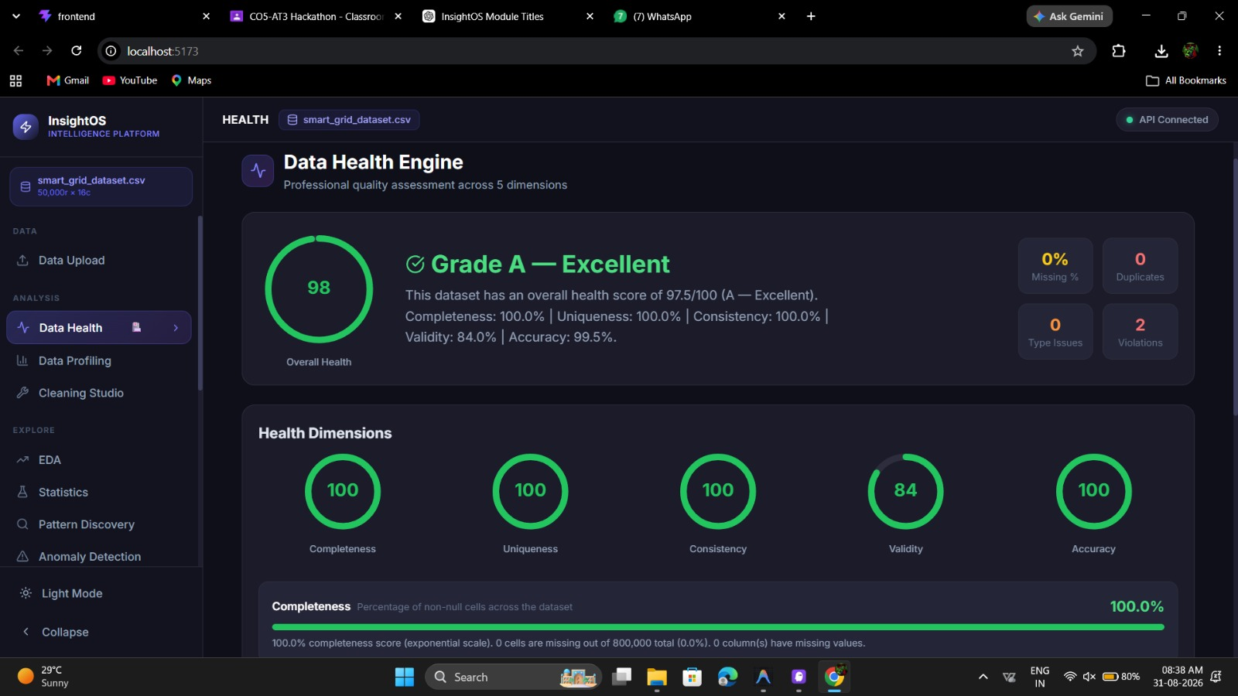
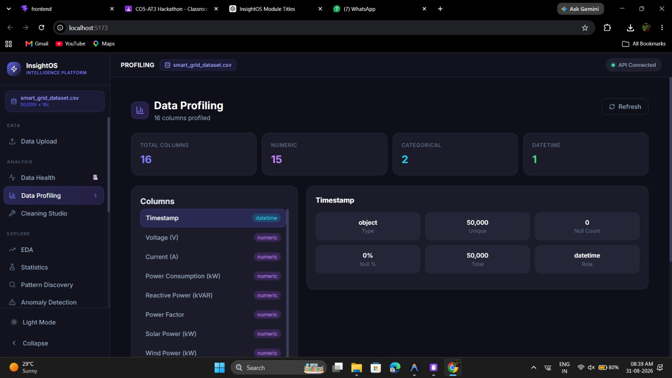
Module 1: Automated Data Analysis & Profiling
Data Health & Quality Scoring – Checks missing values, duplicates, errors, and inconsistent data.
Statistical Profiling – Automatically calculates mean, median, minimum, maximum, standard deviation, and data distribution.
EDA & Visualization – Generates graphs and charts to understand energy consumption and generation patterns.
Correlation Analysis – Identifies relationships between parameters such as load, voltage, generation, and consumption.

Slide 6
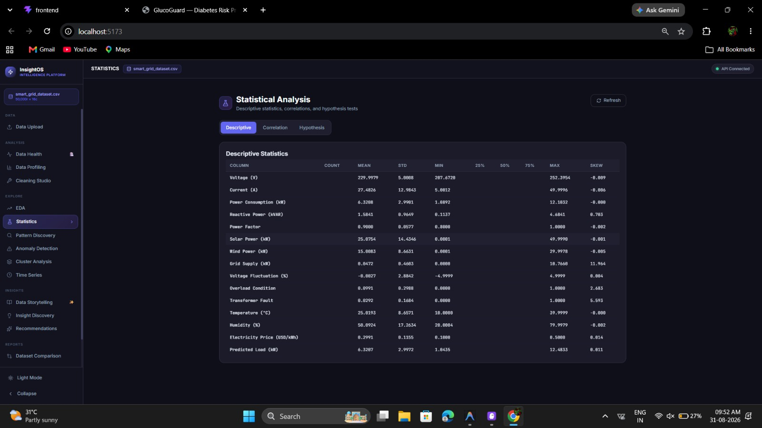
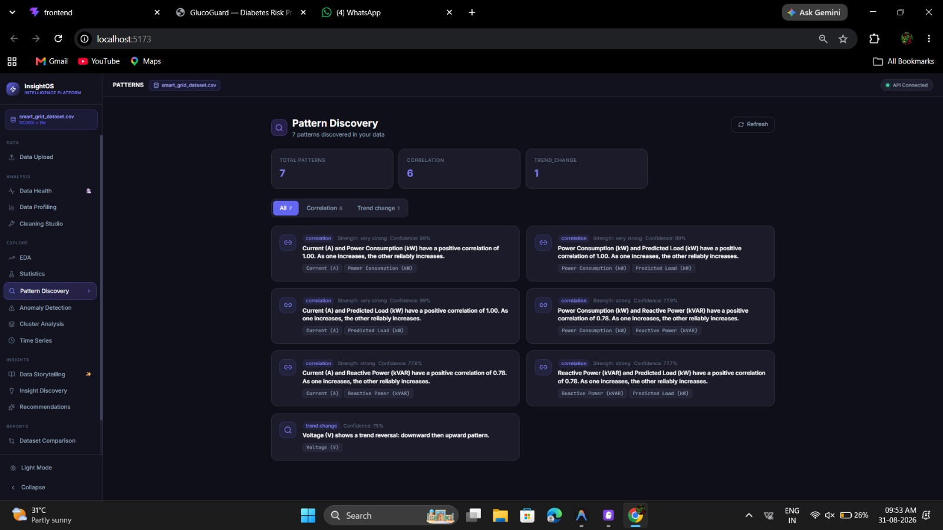
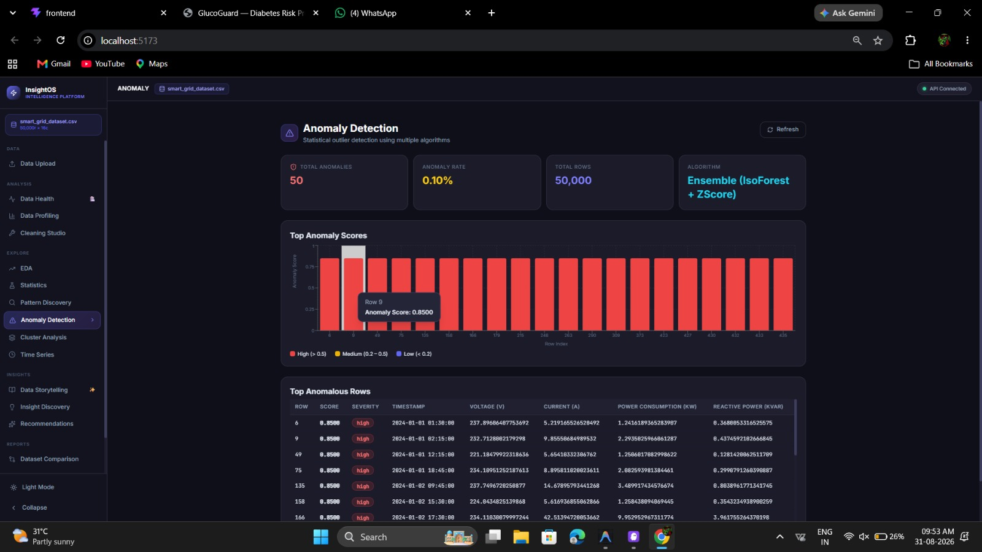
Module 2: Advanced Pattern, Anomaly & Predictive Insights
Pattern Discovery – Identifies recurring energy consumption and generation patterns.
Anomaly Detection – Detects unusual energy usage, sudden load changes, and abnormal grid conditions.
Cluster Analysis – Groups similar consumers, resources, or energy usage profiles for better analysis.
Time-Series Analysis – Studies energy trends over time and supports demand and generation forecasting.
Statistical & Hypothesis Testing – Validates patterns and determines whether observed changes are statistically significant.

Slide 7
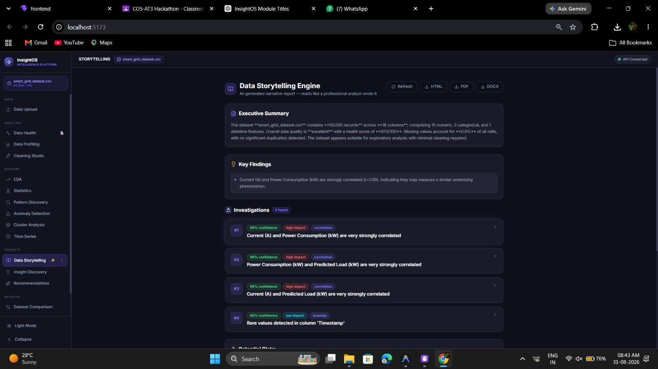
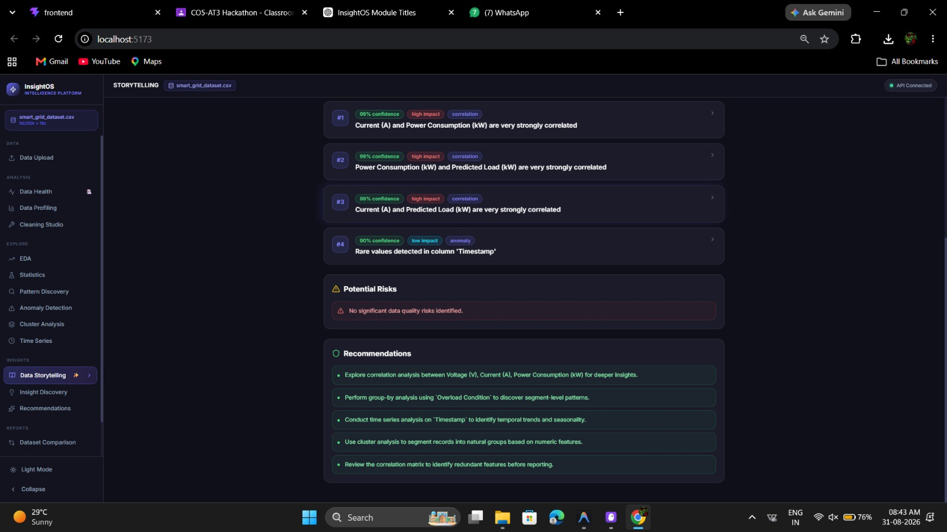
Module 3: Data Storytelling & Reporting
Automated Executive Summaries – Generates concise summaries of important energy and grid insights.
Key Findings & Risk Detection – Highlights critical findings, anomalies, risks, and potential operational issues.
Evidence-Based Recommendations – Provides actionable recommendations based on analyzed data and identified patterns.
Dataset Comparison & Drift – Compares datasets over time and detects changes, inconsistencies, or data drift.
HTML, PDF & DOCX Reports – Automatically generates professional reports in multiple formats for easy sharing.

Slide 8
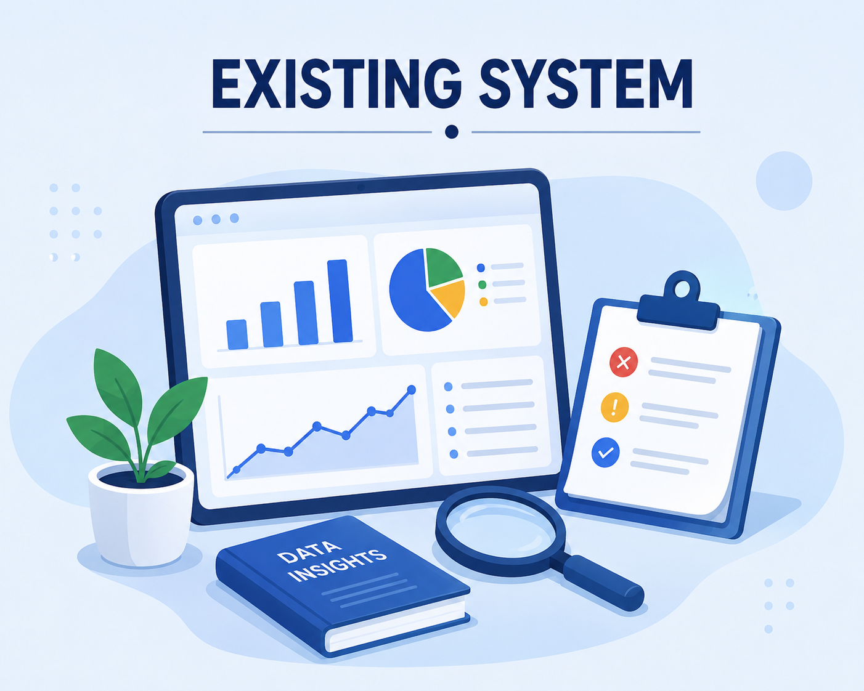
EXISTING SYSTEM
Existing EDA tools mainly generate statistical summaries and visualizations without providing meaningful explanations.
Data cleaning often requires significant manual intervention and technical expertise.
Traditional tools provide limited support for automated reporting and insight generation.
InsightOS uses intelligent algorithms to automatically discover correlations, anomalies, and trends that may not be obvious through manual analysis.

Slide 9
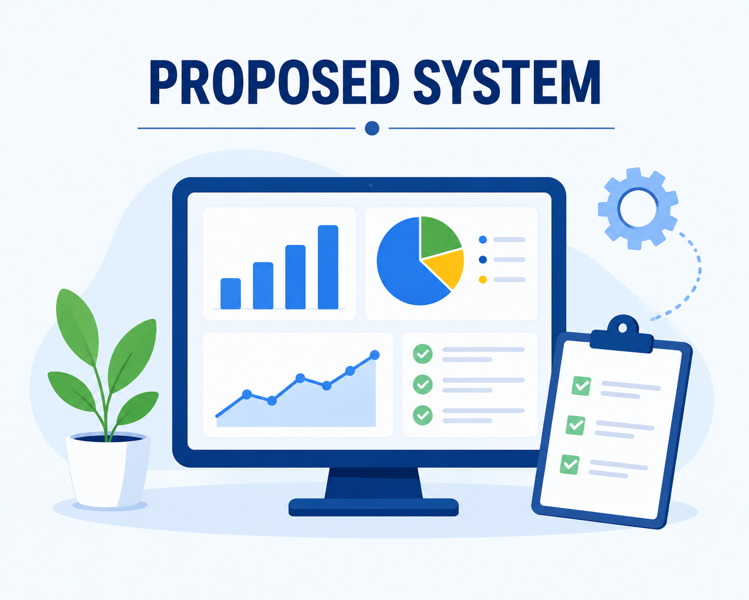
PROPOSED SYSTEM
Automated Dataset Analysis: Accepts CSV and Excel datasets and automatically performs dataset profiling, schema detection, and data type identification.
Intelligent Data Preprocessing: Cleans the dataset by handling missing values, removing duplicates, treating outliers, and transforming data for accurate analysis.
Exploratory Data Analysis (EDA): Generates statistical summaries, interactive visualizations, correlation analysis, and distribution plots automatically.
Pattern Discovery & Insight Generation: Detects hidden patterns, trends, anomalies, clusters, and relationships using statistical and machine learning techniques.

Slide 10
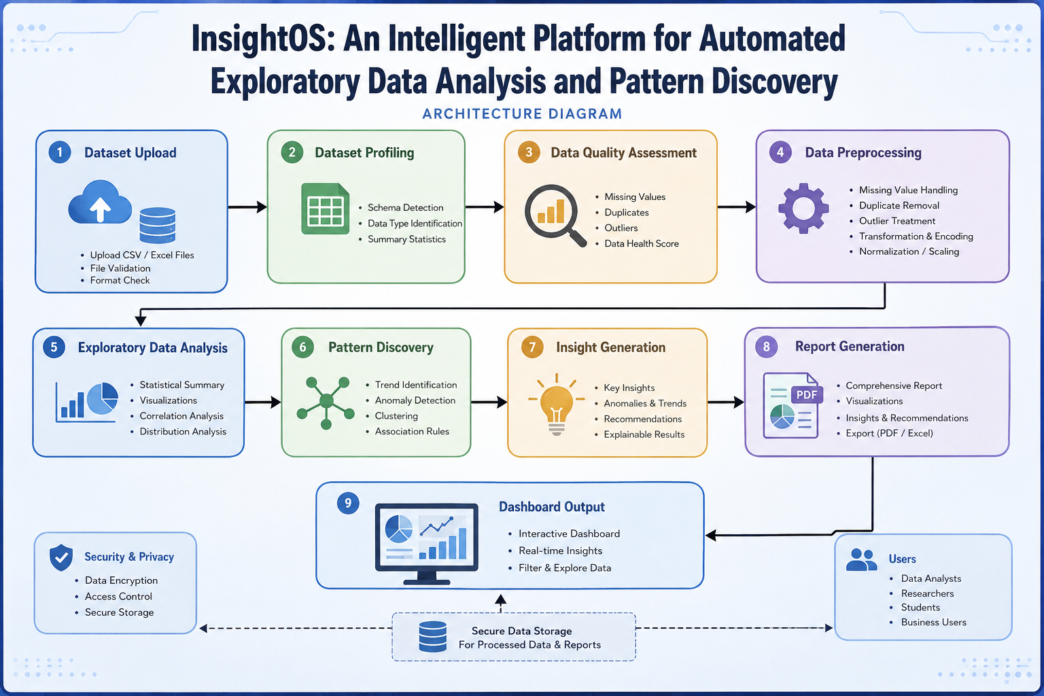
ARCHITECTURE DIAGRAM

Slide 11

CONCLUSION
InsightOS automates the complete Exploratory Data Analysis (EDA) process, reducing manual effort and saving time.
The platform improves data quality by detecting and handling missing values, duplicates, outliers, and inconsistencies automatically.
It generates meaningful insights, visualizations, and statistical reports to support effective data-driven decision-making.
InsightOS provides a fast, accurate, scalable, and user-friendly solution for automated data analysis and pattern discovery.

Slide 12
REFERNCES
A. Kumar, S. Verma, and P. Singh, “Automated Exploratory Data Analysis Using Artificial Intelligence Techniques,” Proceedings of the IEEE International Conference on Data Science and Advanced Analytics, pp. 112–118, 2024.
T. McKinney, J. Reback, and P. Hoefler, “Pandas: Powerful Data Analysis and Manipulation Library for Python,” Journal of Open Source Software, vol. 9, no. 95, pp. 1–8, 2024.
F. Pedregosa, G. Varoquaux, A. Gramfort, et al., “Scikit-learn: Machine Learning in Python for Data Analysis and Pattern Discovery,” Journal of Machine Learning Research, vol. 25, pp. 1–24, 2025.
S. Waskom, M. L. Waskom, and Contributors, “Statistical Data Visualization Using Seaborn for Exploratory Data Analysis,” Journal of Open Source Software, vol. 10, no. 101, pp. 1–7, 2025.
R. Sharma, P. Gupta, and N. Patel, “An Intelligent Platform for Automated Data Profiling, Pattern Discovery, and Insight Generation,” International Journal of Data Science and Analytics, vol. 18, no. 2, pp. 145–158, 2026.

Slide 13
THANK YOU

